Slide 1
OceanSITES DMT Report
OceanSITES 2016
11th Steering Committee and 8th Data Management Team Meeting
National Oceanography Centre, Southampton, United Kingdom 25 - 29 April 2016

Slide 2
GDAC / RDAC Interactions
ISSUE: Individual PIs have the ability to self declare as RDACS. However, when they lack the ability to create the files, the burden for tech support falls on the GDACs. This isn’t sustainable.
ACTION: Determine a better way to distribute the tech support role across DMT. (“Adopt a PI”, rotating help desk etc)
ACTION: Create a repository for code sharing at github.com/oceansites. (E.g. github.com/ioos and ioos.github.io)
ACTION: Website enhancements to create a better knowledge base.

Slide 3
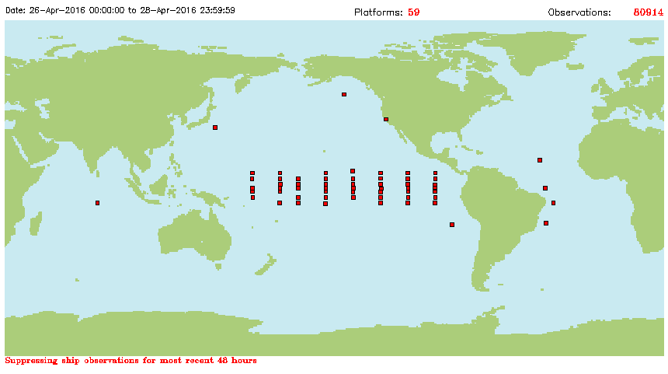
Real Time Tracking
ISSUE: Lack of information on PLATFORM/WMO ID prohibits tracking real time GTS distribution (www.osmc.noaa.gov for GTS tracking)
ACTION: Review and update OceanSITES Master Catalog spreadsheet

Slide 4
GDAC Error Tracking/Correcting
ISSUE: GDACs will be instituting more error tracking and may have the ability to correct minor errors. This breaks the provenance tracking and a decision to proceed is needed.
As of April 12, 2016 Checked by a Program:
Site code problems: 477 data files
Platform code problems: 509 data files
Unknown institution: 1 file
Unknown PI: 1 file
Unknown convention: 2883 data files
Unknow vertical range: 79 data files
Time dimension starting at 1950-01-01T00:00:00Z: 21258 (over 30908)
Some bad standard names, e.g. WC_DissNitrogen

Slide 5
Real Time/Delayed Mode File Publication
ISSUE: Delayed mode files exist with higher quality data than the original real time files. Should we serve both, or should D files replace R files?
KEO | OS_KEO_2007KE003B_R_TS-1day.nc
KEO | OS_KEO_2007KE003B_D_MET_10min.nc
KEO | OS_KEO_2007KE003B_D_RAD_2min.nc
KEO | OS_KEO_2007KE003B_D_SALT_1hr.nc
KEO | OS_KEO_2007KE003B_D_TEMP_10min.nc
ACTION: Decision, update Data Provider Guide. Determine implementation issues.

Slide 6
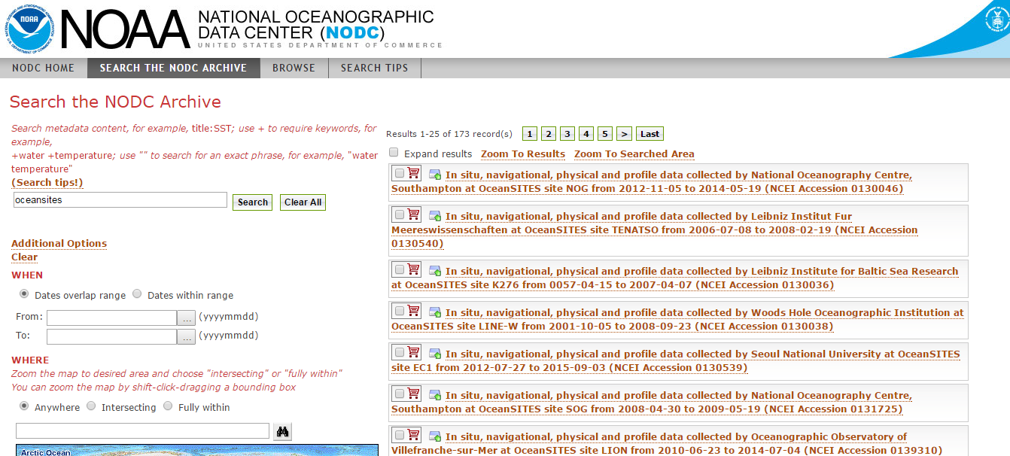

ISSUE: NCEI Archive provides another access point to OceanSITES data which may confuse users and detract from branding goals.
NCEI archive Package http://data.nodc.noaa.gov/ndbc/oceansites/
NCEI Geoportal: http://data.nodc.noaa.gov/geoportal/
NCEI THREDDS Server
http://data.nodc.noaa.gov/thredds/catalog/ndbc/oceansites/catalog.html
ACTION: Steering Team webinar to share information.

Slide 7
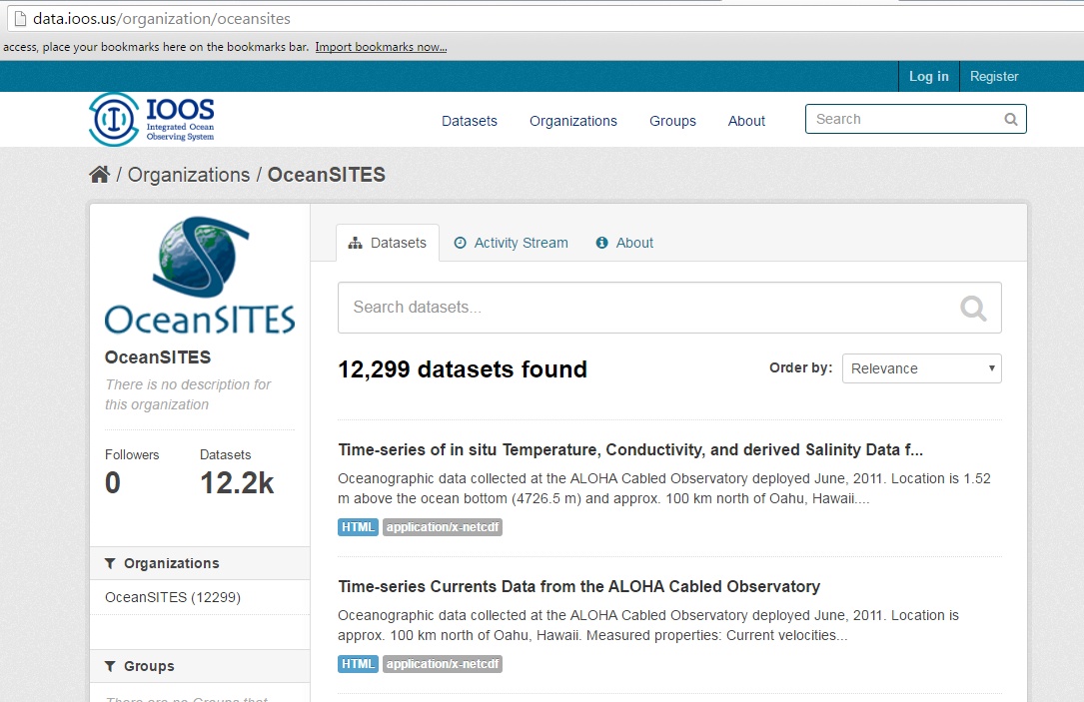
Product development, long time series aggregation etc
ISSUE: The volume of files is large and growing imposing a burden on data users to determine what to use and how. We need a strategy to highlight the desirable data sets while not eliminating the individual files from the overall data system/archive pathway.

